Slide 1





D
L
GROUP 10
Agustin, Birk, Karol

Slide 2
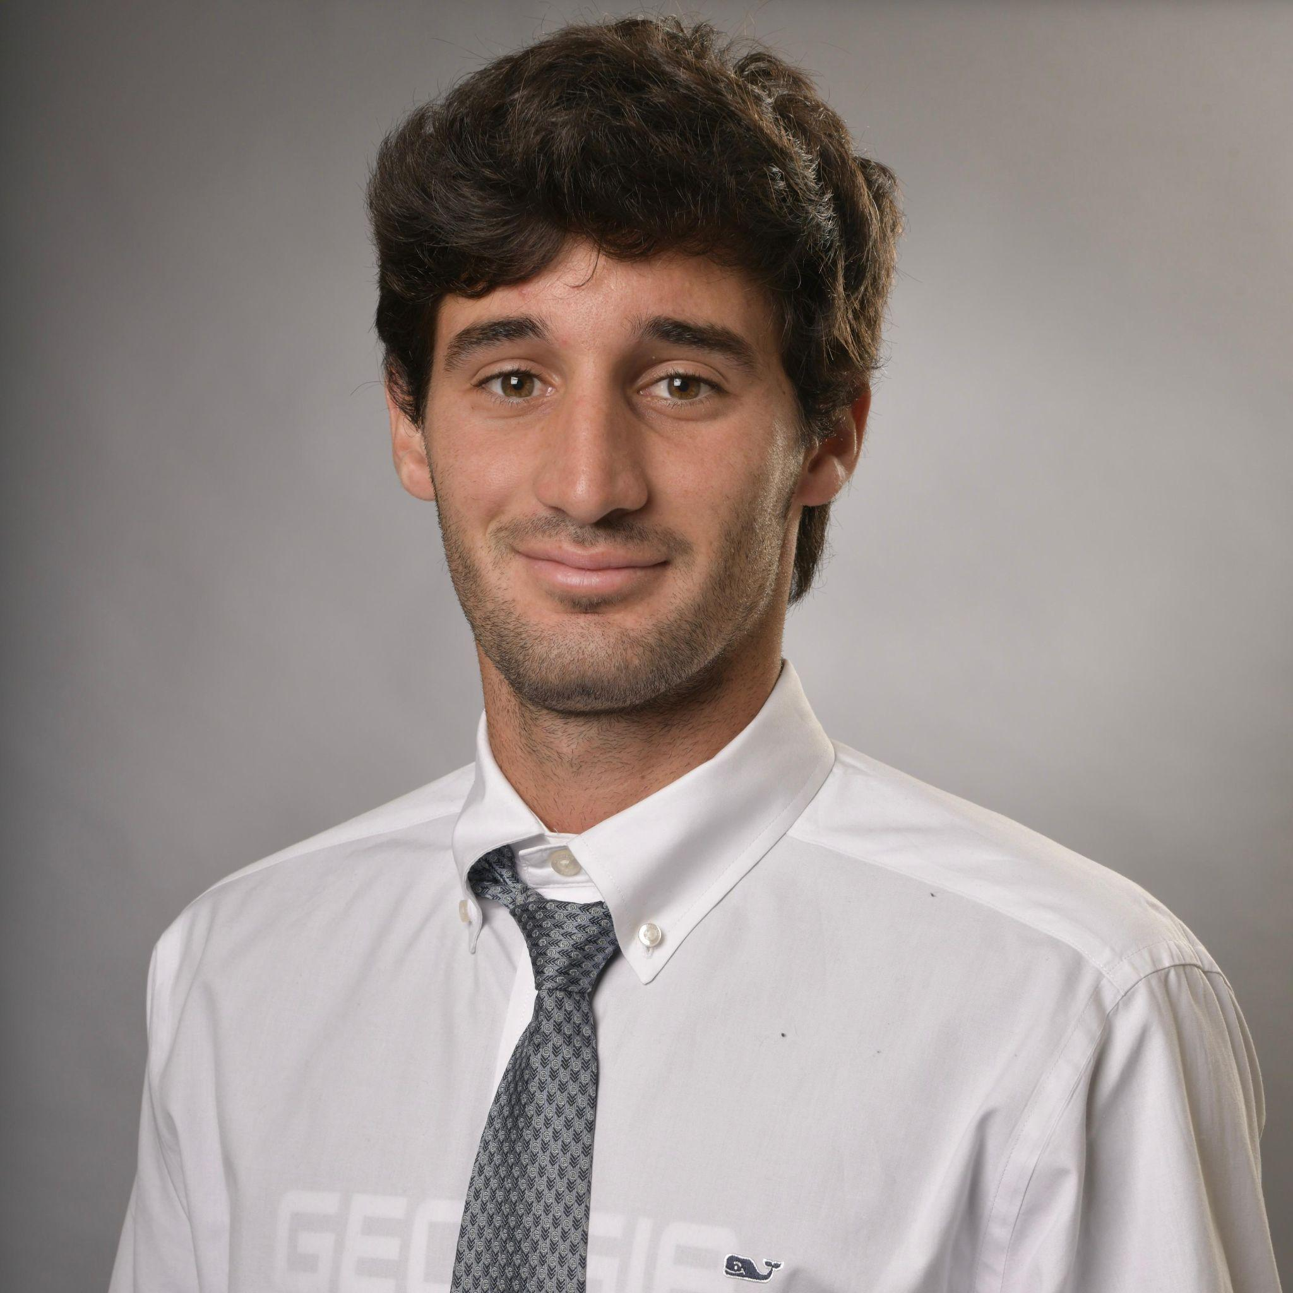

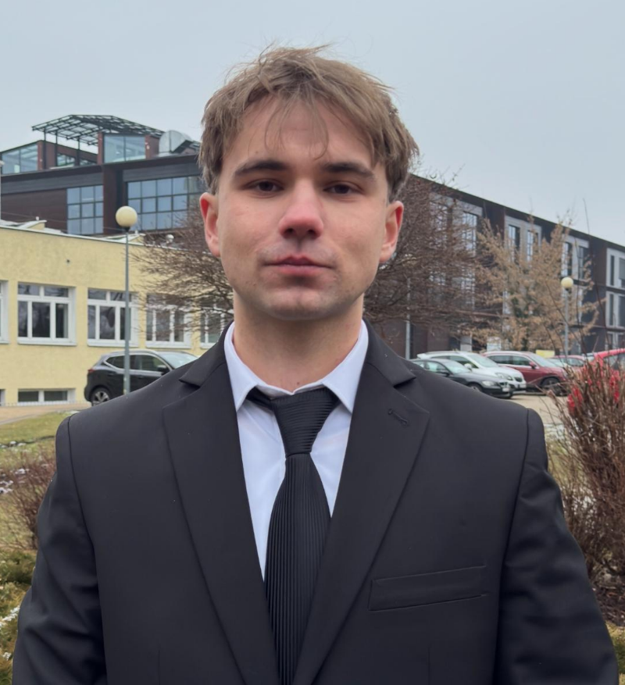
Team Members
Agustin
Birk
Karol

Slide 3

Table of Contents
System Context
Model Overview
Model Card
Dataset Card

Slide 4
System Architecture Summary
Web application for uploading or pasting articles
Backend API handles classification requests
Preprocessing module cleans & vectorizes text (TF-IDF)
Dense Neural Network model produces probability score
Results and metrics stored for monitoring & evaluation

Slide 5

How the System Works
User submits article (title + text)
Text cleaned & converted into features
Model predicts Fake/True + confidence score
Interface shows results and key words
Logs saved for traceability and review

Slide 6


Core System Functions
Accept article input via web page or API
Produce Fake/True label + confidence (0–1)
Validate API inputs
Clean & standardize text before inference
Categorize as Likely Fake / Uncertain / Likely True
Log anonymized results

Slide 7
Performance & Quality Constraints
Inference ≤ 3 s per article (CPU)
Web UI shows results ≤ 2 s after prediction
~95% uptime during testing sessions
Secure HTTPS communication + auth tokens
Modular design → easy maintenance & future scaling

Slide 8
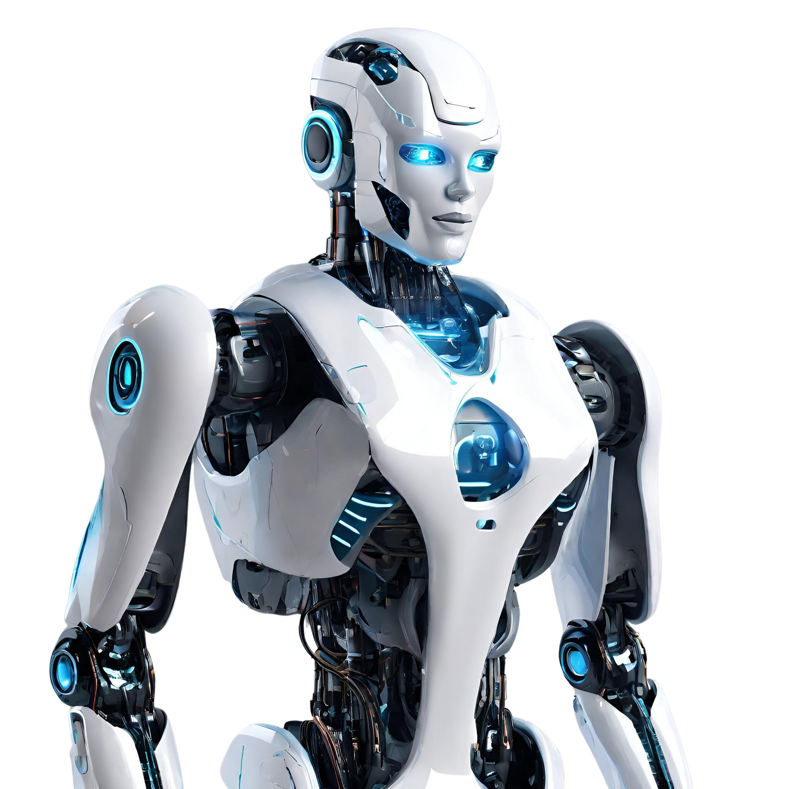
Performance Goals
F1-score
Each prediction
≥ 0.85 on test set
≤ 3 s on laptop CPU
Deterministic training
Review ≥ 10
misclassified samples for analysis
with fixed seeds

Slide 9
Challenges & Solutions
Bias: political tone → false fake detections → evaluate by subject
Imbalance/leakage: uneven classes → use stratified splits + regularization
Overfitting: sparse features → apply dropout & early stopping

Slide 10
Responsible AI Principles
Educational tool – not a fact-checking engine
Shows confidence & influential words for transparency
Processes data locally (no PII stored)
Follows ethical AI and human-oversight guidelines

Slide 11

Future Development (M2–M3)
Replace Dense NN
Expand API
Dashboard
Integration
with DistilBERT for context awareness
Deploy full web application
Implement continuous evaluation dashboard
Integrate fact-checking and source credibility modules

Slide 12
The chosen model and the reasons behind the choice

Slide 13


Model Overview
Goal Classify news articles as real or fake based on their text. | Input Concatenated title + body of each article. | Output Probability of the article being fake → binary classification. | Representation Text → TF-IDF vectors. Captures important words efficiently.
Model: Feed-Forward Dense Neural Network • Layers: Fully connected (Dense) + ReLU activations • Dropout for regularization • Sigmoid output for fake/real probability • Trained with Binary Cross-Entropy + Adam optimizer
Notes:
We’re treating fake-news detection as a simple text-classification problem, where our model learns patterns in the word distributions of fake vs. real articles

Slide 14

Models considered
RNNs (LSTM / GRU): capture sequence and word order → Accurate but slow and resource-heavy.
CNNs: detect local word or phrase patterns → Efficient but limited for long-range context.
Transformers (BERT / DistilBERT): best contextual understanding → High accuracy, but require more data and compute power.
Notes:
We reviewed more complex NLP architectures like RNNs, CNNs, and Transformers, but these add training complexity and aren’t necessary yet for a baseline.

Slide 15
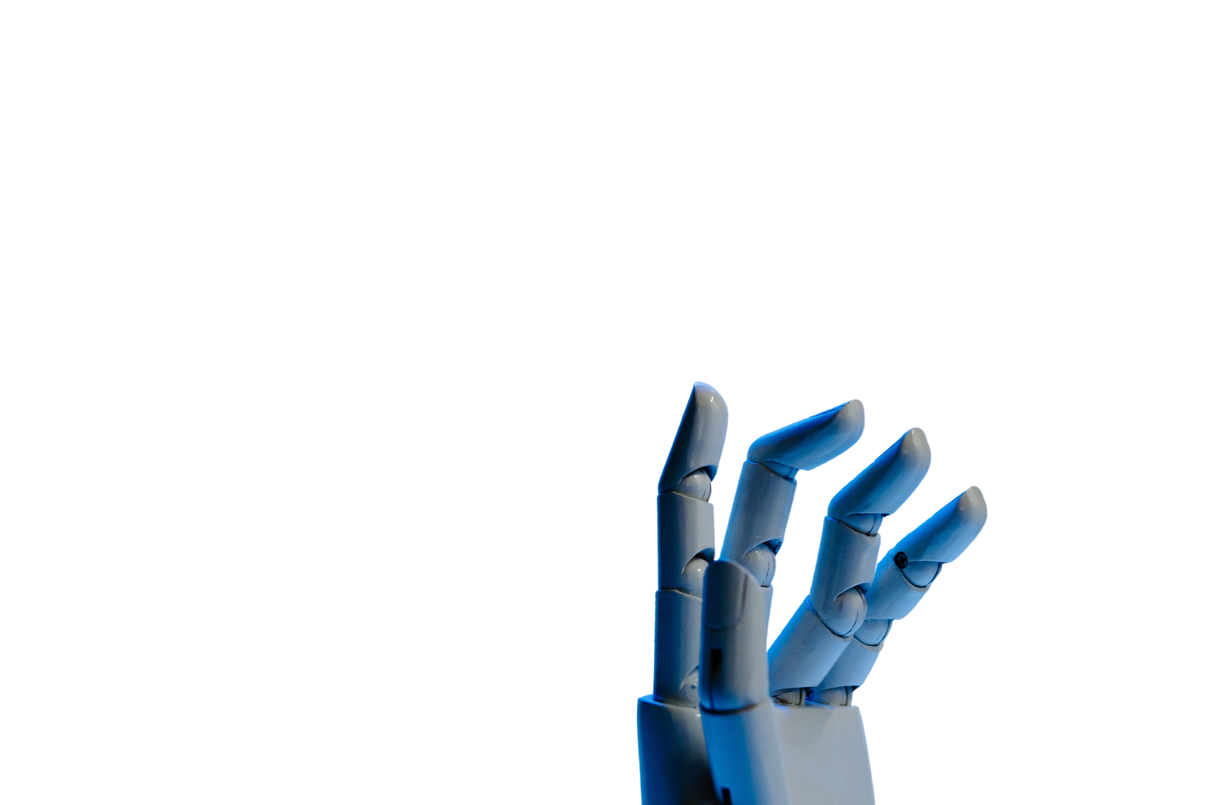
Why This Model & What’s Next
• Chosen model: Feed-forward Dense Neural Network
→ Simple, interpretable, and efficient for TF-IDF text data.
• Why it fits:
• Balanced trade-off between simplicity and expressive power
• Easy to reproduce and compare in future experiments
• Next steps (Milestones 2–3):
• Explore Transformer-based models (DistilBERT) for contextual understanding
• Compare performance and robustness
• Deploy best model in final software system
Notes:
This simple neural network sets a strong baseline — it’s fast, explainable, and gives us a benchmark to improve upon when we move to Transformers later.

Slide 16
Model &
Data Cards

Slide 17
Transparency in DL: Model & Data Cards
• Model and Data Cards help us explain how and why a DL system works.
→ Both are documentation tools for ML transparency.
• Model Card: explains how the model works, its purpose, and ethical limits.
• Data Card: describes what data was used, its source, and possible biases.
• They help us insure DL systems are responsible, fair, and easier to understand.
Notes:
This simple neural network sets a strong baseline — it’s fast, explainable, and gives us a benchmark to improve upon when we move to Transformers later.

Slide 18
Model Card - Summary
• The goal of the model is to find out if a news article looks real or fake based on how it’s written.
• Intended Use:
→ Educational tool to study misinformation (not a fact-checker).
→ Designed to aid users increase awareness about misinformation.
• Planned results: We want the model to reach around 85% accuracy (F1-score).
• Factors: The topic of the article, the writing style, and the fact that all the text is in English, may cause variation.
• Ethics: Must be reviewed by humans.
→ Could reflect dataset biases.
Notes:
This simple neural network sets a strong baseline — it’s fast, explainable, and gives us a benchmark to improve upon when we move to Transformers later.

Slide 19
Dataset Card - Summary
• Source: Kaggle dataset by Clément Bisaillon (based on ISOT).
• Composition: ~44 000 English articles – columns (ID, title, text, subject, date, label).
→ There is good balance between real news (~45%) and fake news (~55%) in the dataset.
• Purpose: Train/test models that detect misinformation.
• Splits: 80 % train / 10 % validation / 10 % test.
• Bias & Limitations: Mostly political, English-only, writing style influences labels. • Ethics: Public data; no personal information.
Notes:
This simple neural network sets a strong baseline — it’s fast, explainable, and gives us a benchmark to improve upon when we move to Transformers later.

Slide 20
Key Takeaways & Next Steps
• These cards make our project clearer and easier to explain.
• They help us stay organized and aware of the model’s limits.
• In short: these cards are our starting point for building a fair and transparent DL/AI project.
DATA
CARD
MODEL CARD
FFN TRAINING
FINE TUNING
TESTING
PHASE
FUTURE MODEL
Notes:
This simple neural network sets a strong baseline — it’s fast, explainable, and gives us a benchmark to improve upon when we move to Transformers later.

Slide 21
Thank you!
See you in Milestone 2!

Slide 22
A picture is worth a thousand words

Slide 23
Market Research
Elaborate on the featured statistic
43%
60%
35%
Elaborate on the featured statistic.
Elaborate on the featured statistic.
Elaborate on the featured statistic.

Slide 24
123,456,789
Elaborate on the featured statistic.

Slide 25
















































Resource
Page
Use these design resources in your Canva Presentation.
You can find these fonts online too. Happy designing!
Don't forget to delete this page before presenting.
This presentation template uses the following free fonts:
Titles: Archivo Black
Headers: Montserrat
Body Copy: Open Sauce

Slide 26

Credits
This presentation template is free for everyone to use thanks to the following:
SlidesCarnival for the presentation template
Pexels for the photos
Happy designing!

